Slide 1

Build software like sean combs
Part 1 - How to Build a Better Domain Model

Slide 2
Part 1 - How to Build a Better Domain Model
Part 2 - Command and Notifications
Part 3 - Designing a Refactor-Proof Architecture

Slide 3
ADGENDA

Slide 4
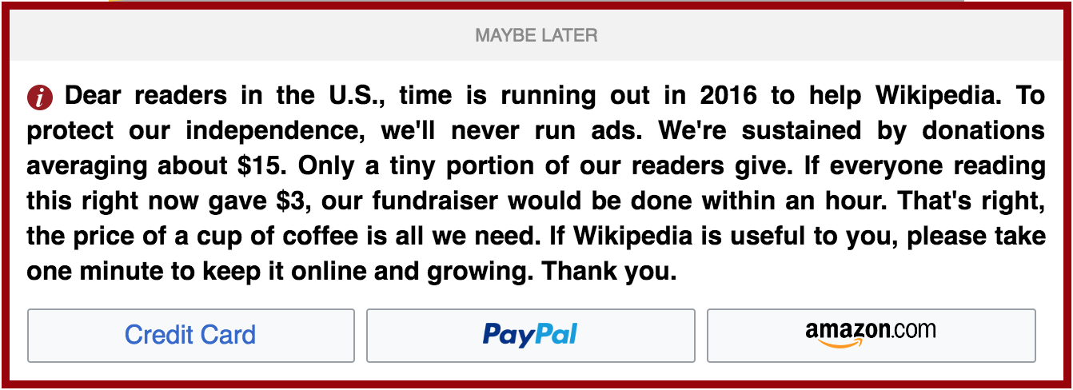
references

Slide 5
domain
2 + 2 - 1 = 3
Math Equation

Slide 6
domain
Expression
Result
2 + 2 - 1 = 3
Math Equation

Slide 7
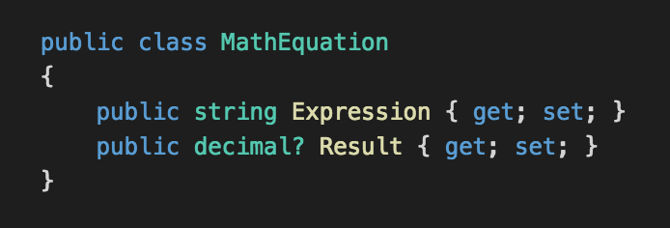

Slide 8

anemic domain model
The use of a software domain model where the domain objects contain little or no business logic (validations, calculations, business rules etc.).

Slide 9
anemic domain model
Logic cannot be implemented in a truly object-oriented way.
Violation of the encapsulation and information hiding principles.

Slide 10
anemic domain model
Needs a separate business layer to contain the logic otherwise located in a domain model. It also means that domain model's objects cannot guarantee their correctness at any moment, because their validation and mutation logic is placed somewhere outside (most likely in multiple places).
Makes a model less expressive.

Slide 11


Slide 13
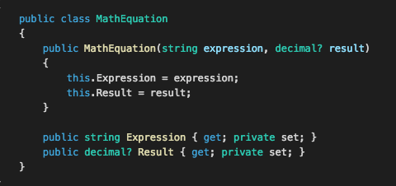

Slide 14
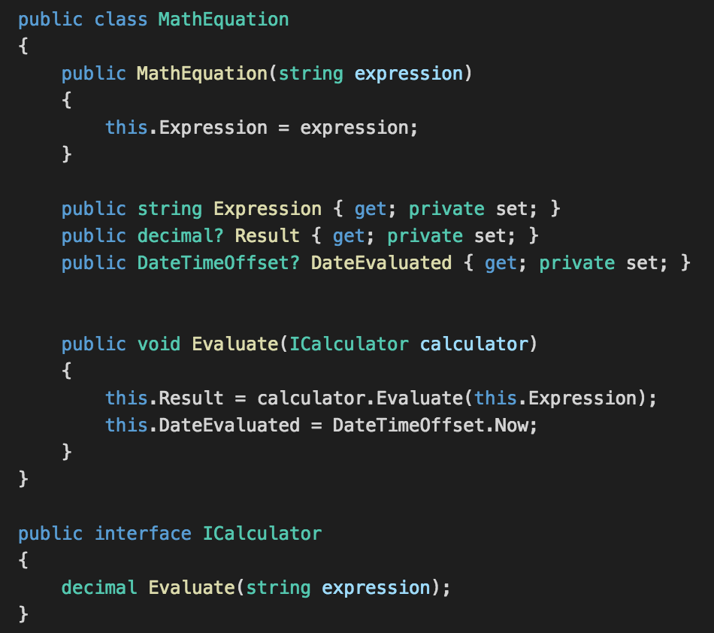

Slide 15
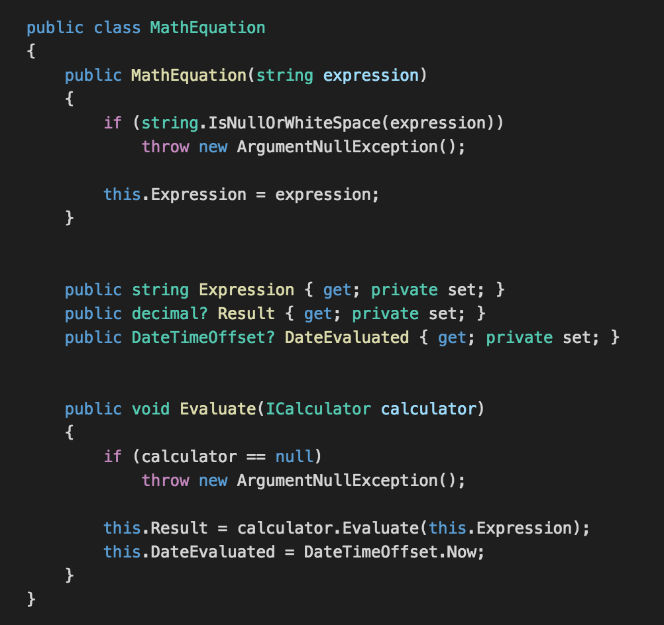

Slide 16
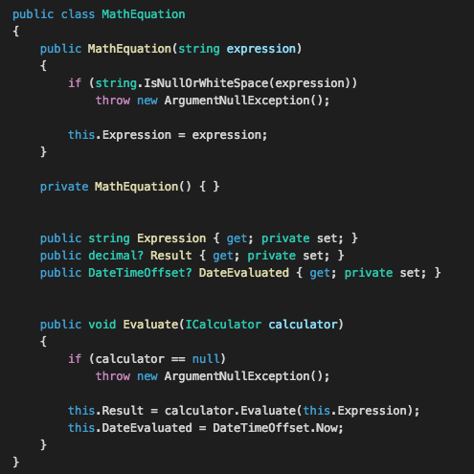

Slide 17
Domain events pattern
The essence of a Domain Event is that you use it to capture things that can trigger a change to the state of the application you are developing.

Slide 18
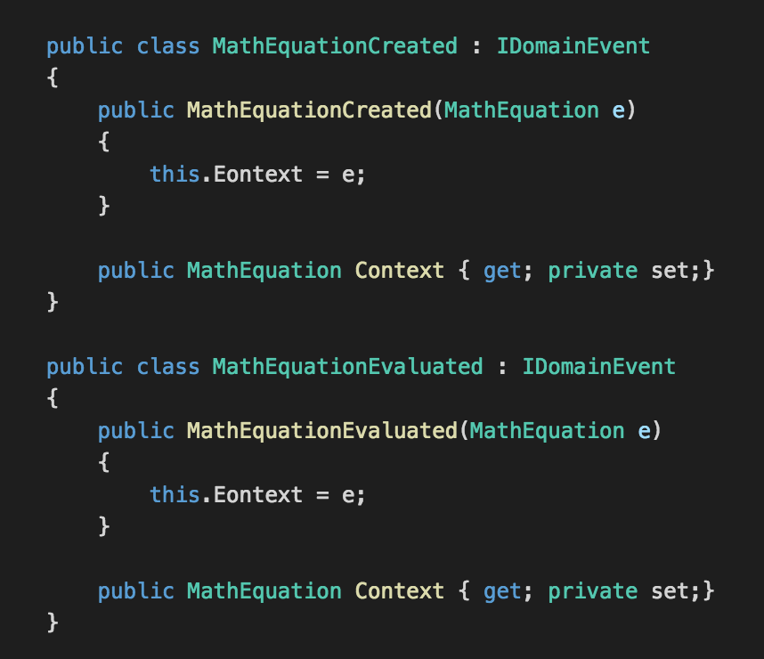
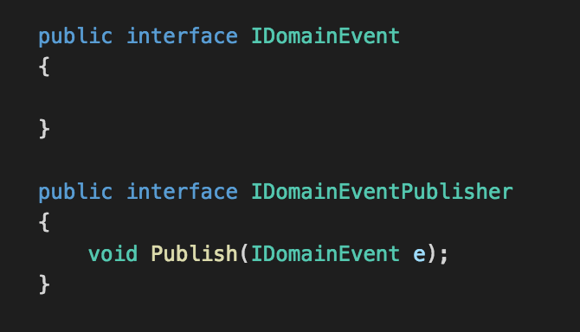

Slide 19
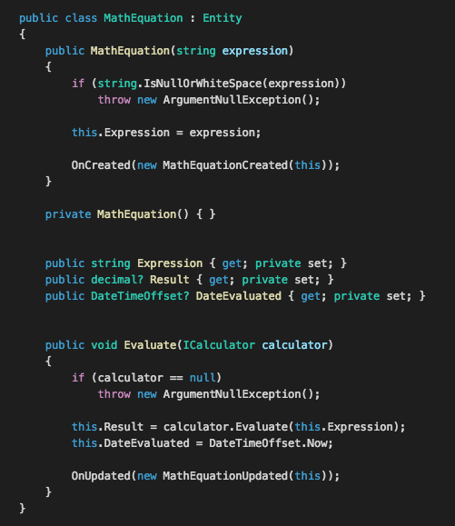

Slide 20
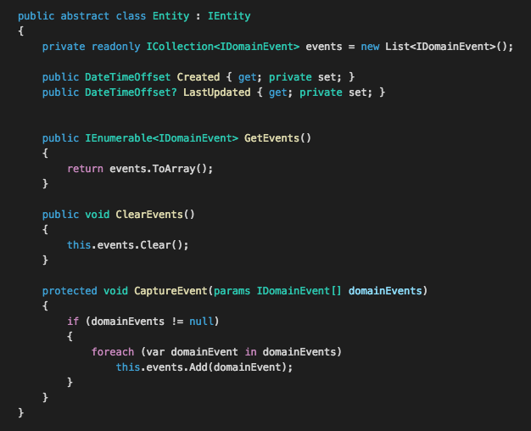

Slide 21
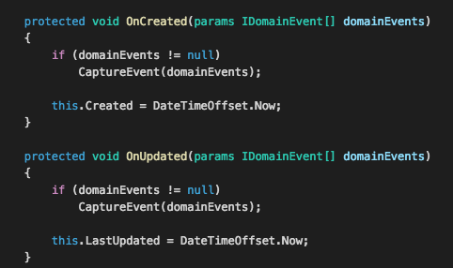

Slide 22
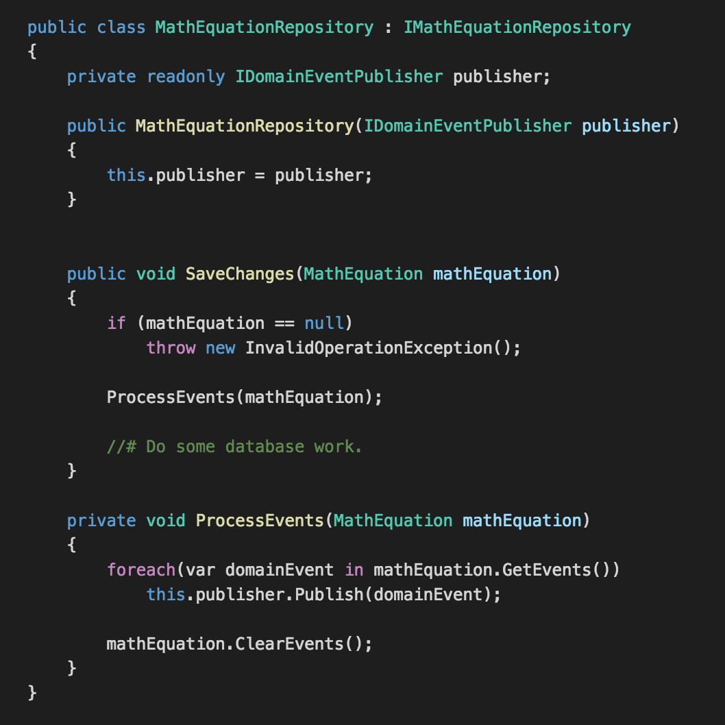

Slide 23

Source code
https://github.com/neekgreen/calculator

Slide 24
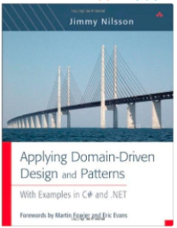
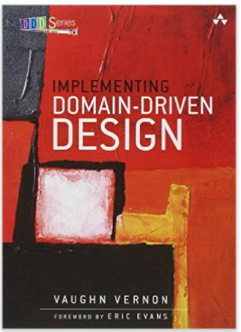
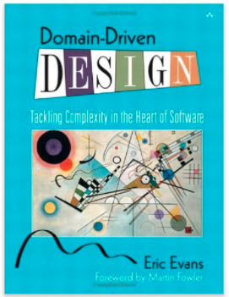
Resources

Slide 25
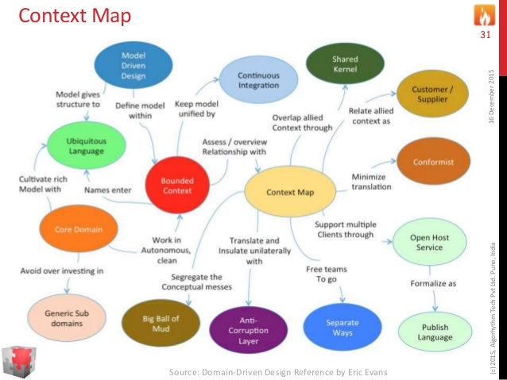

Slide 26
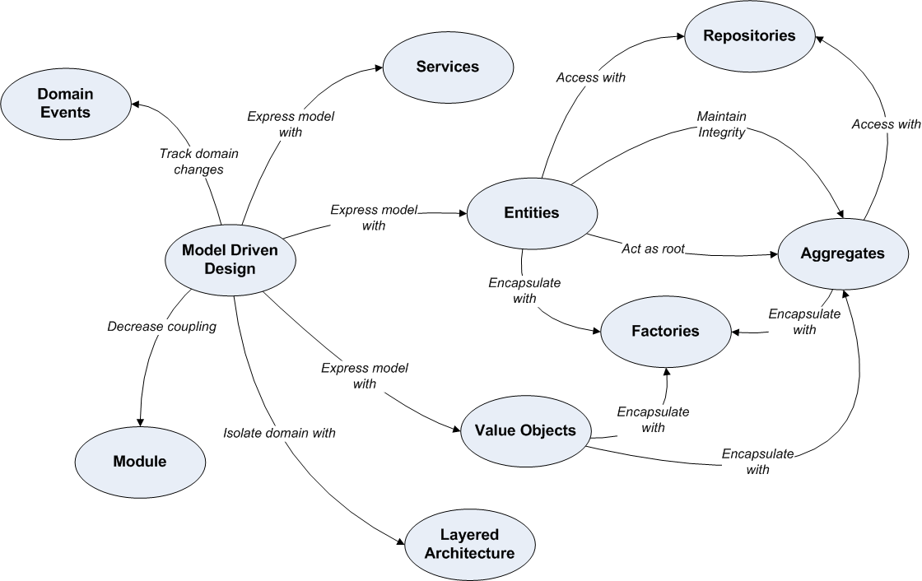

Slide 27

DEMO

